Slide 1
A report on the findings of Big Mountain Resort’s pricing strategy
by Sheik Mohammad Boni Sadar

Slide 2
A sneak peek into the present ski market
The ski and snowboard resorts industry has benefited from favorable economic conditions over most of the five years to 2023. Improvements in household income enabled families to increase their spending on vacations.
Overall, industry revenue increased at a Compound annual growth rate (CGAR) of 3.7% to $4.6 billion USD over the five years to 2023.
Major players Vail Resorts and Alterra Mountain expanded their Epic Pass and Ikon Pass, enabling consumers to ski at multiple mountain locations of their choice. These packages helped these major players better contend with shorter snow days at selected locations under the company's umbrella.
Winter tourism is not only sensitive to climate change, but it's also vulnerable to customer income and spending patterns.
Source: https://www.ibisworld.com/united-states/market-research-reports/ski-snowboard-resorts-industry/

Slide 3
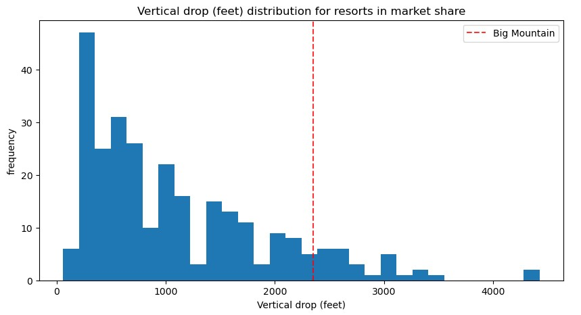
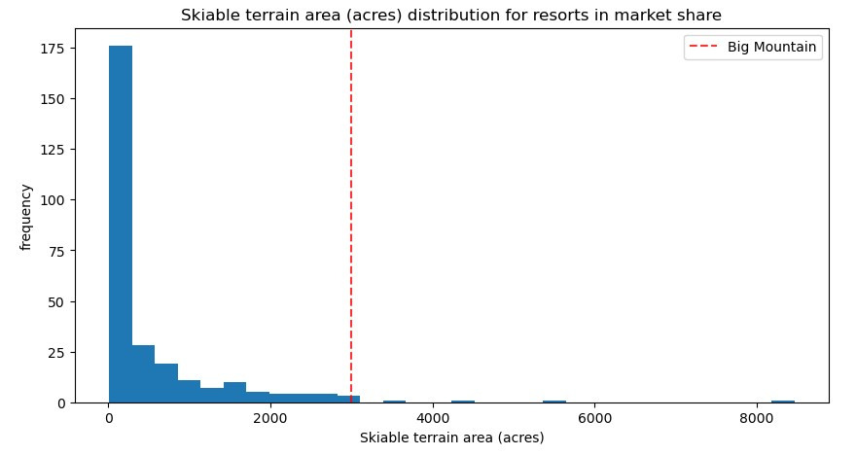
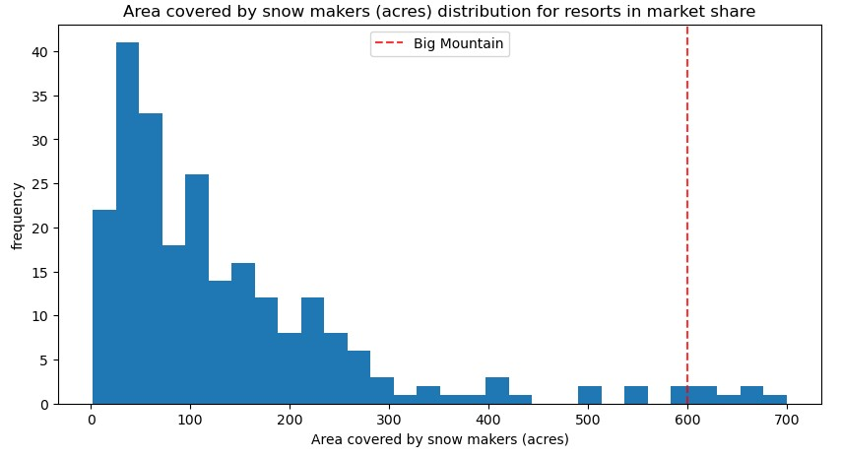
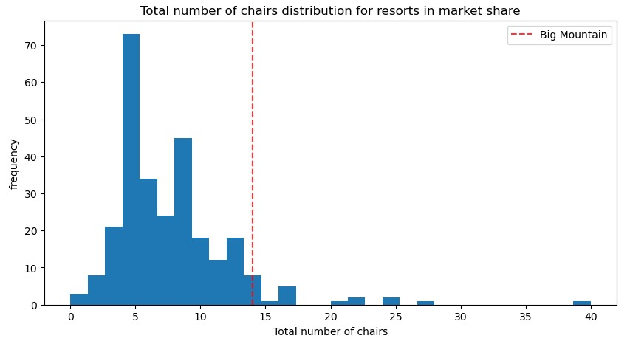
A look into the matter at hand
Big Mountain, with the recent addition to the chair lift, is facing issues with increased operating cost. It seemed to have problem finding ways to compensate for the increased operating cost of the chair lift.
With Big Mountain’s beautiful parks and being amongst the highest in many amenities like snow making area, vertical drop, number of total chairs, amount of skiable terrain, hopefully it’s not going to be a problem.
The red line representing Big Mountain’s position among 330 resorts in U.S. with only a few scoring higher than Big Mountain.
By focusing on the facilities that contribute most towards ticket price, Big Mountain could push the ticket price to a value that will successfully compensate for the $1.5M rise in operating cost.
Dashed red line representing Big Mountain’s position among 330 resorts in the US
Vertical drop
Skiable terrain area
Area covered by snow making
Total no. of chair lifts

Slide 4
Key findings and recommendations
One of most contributing features to the ticket price is found to be vertical drop.
It yields most beneficial results when combined with chair lift and adding an additional run.
150m increase in vertical drop by adding a run with the addition of a chair lift predicts an increase of $8.61 in ticket price.
Over the season, this could be expected to amount to $15M.

Slide 5
Modeling results and analyzing
Our final model predicted a ticket price of $95, current price being $81 at this moment. Even with the Mean Absolute Error of 10%, it shows that there is room of increase.
Mean absolute error is arguably the most intuitive of all the metrics, this essentially tells you that, on average, you might expect to be off by around $10 if you guessed ticket price based on an average of known values.

Slide 6
Different scenario modeling
Increase vertical drop with a run and an chair lift with additional snow making coverage
By adding an additional 2 acres of snow making predicts a revenue of 17.32M over the season, not an significant increase from our initial achievement of 15M.
Night skiing area and the longest run
No addition increase in revenue is predicted by increasing the night skiing area or increasing the longest run.

Slide 7
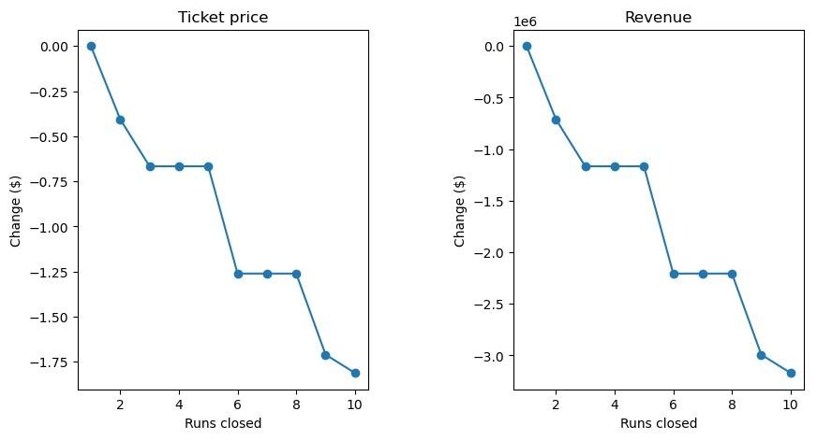
Cutting operational cost
Reducing the number of runs
According to the model closing one run makes no difference.
Closing 2 and 3 successively reduces support for ticket price and so revenue.
If Big Mountain closes down 3 runs, it seems they may as well close down 4 or 5 as there's no further loss in ticket price.
Increasing the closures down to 6 or more leads to a large drop.

Slide 8
Validation and Future Strategy
The validity of our model lies in the assumption that other resorts accurately set their prices according to what the market (the ticket-buying public) supports.
We could also survey customers on price sensitivity to validate if customers would be willing to pay the higher modeled price.
The model is a valuable tool for exploring pricing adjustments based on amenities changes, helping executives plan for future investments in facilities.
Leaders could use the model to estimate revenue impacts of facility changes or price increases.
This could inform budgeting and forecasting.
The model allows the business to test different pricing and facility configurations to stay competitive while optimizing revenue.

